Slide 1

AI Service Advisor
by:-Atharv Sharma
Bridging Predictive Maintenance with Financial Strategy
Built with Python & Scikit-Learn

Slide 2


The "Trust Gap" in Auto Repair
Complexity Overload
Customer Distrust
40% of customers defer critical repairs due to fears of "upselling" or opaque pricing.
Modern motorcycles are equipped with intricate sensors (Voltage, RPM, Temp) that overwhelm manual interpretation.
Financial Blind Spots
Mechanics often recommend repairs without a clear understanding of the customer's immediate financial capacity.

Slide 3



The Solution: Dual-Engine AI for Strategic Advice
Our unique approach integrates two powerful AI models to deliver balanced, data-driven recommendations.
The Banker
Evaluates cost and financial risk trade-offs.
The Mechanic
Unified Dashboard
Predicts failures using sensor-driven models.
Combines insights into actionable strategy.
The Mechanic (Random Forest Classifier)
The Banker (Linear Regression Model)
Predicts mechanical failure probability based on real-time sensor data.
Estimates client income stability to assess repair affordability.
The outcome is Strategic Advice that optimizes both safety and financial feasibility.

Slide 4

AI Service Advisor: The Workflow
Data Input
Mechanic enters sensor readings (Voltage, Chain Slack, Vibration) into the Smart Kiosk.
Historical Analysis
AI compares inputs against a vast dataset of 10,000+ historical failure patterns.
Financial Cross-Reference
System cross-references estimated repair costs with the client's financial profile.
Score Generation
Generates a "Health Score" (0-100%) and a "Financial Impact Score" for clear insights.

Slide 5
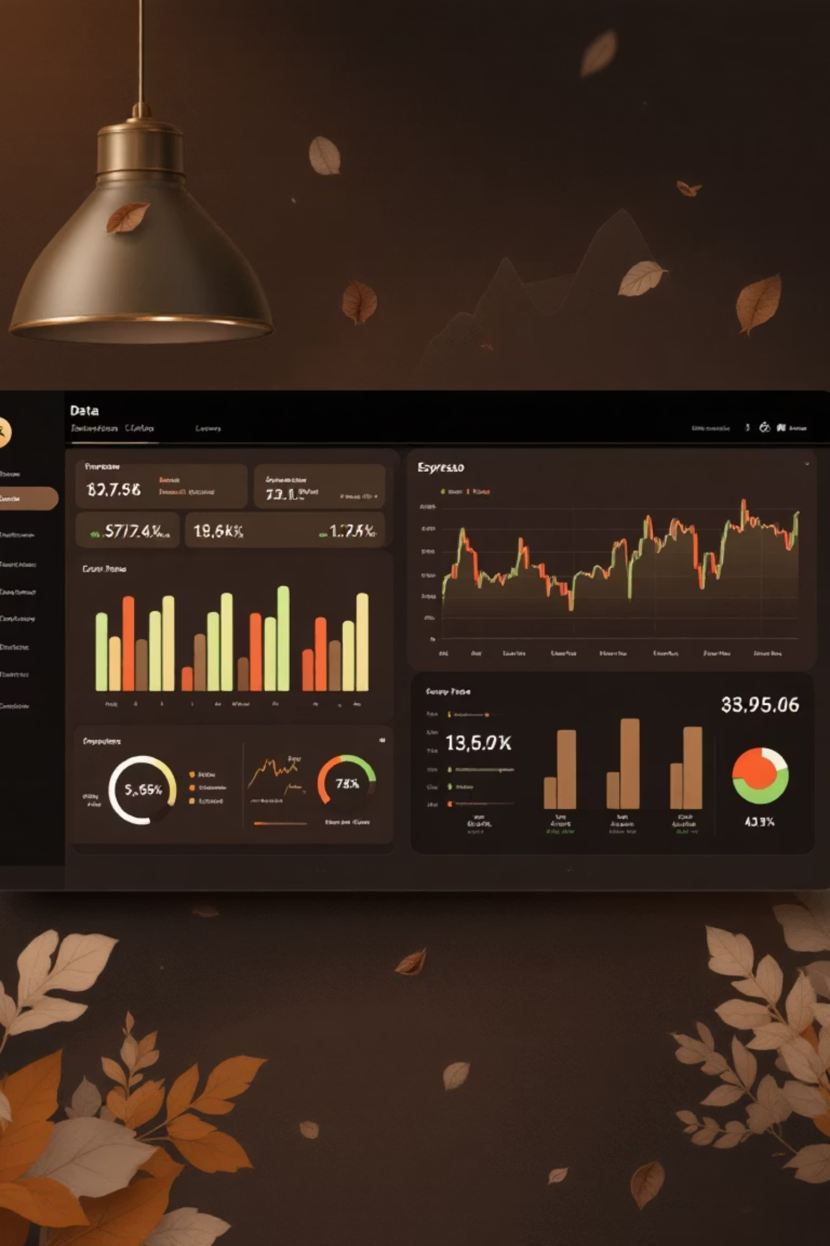
Key Features & Strategic Logic
Real-Time Diagnostics
Instantly flags specific issues, such as "Critical: Battery Voltage < 11V", ensuring immediate attention to critical components.
Dynamic Costing
Automatically maps detected failures to precise parts and labor costs, providing transparent and accurate estimates.
Strategic Decision Logic
If Repair Cost < 5% of Income: "✅ Approved" - Proceed with confidence.
If Repair Cost > 40% of Income: "⚠️ Financial Alert: Recommend EMI Plan" - Suggest flexible payment options.

Slide 6
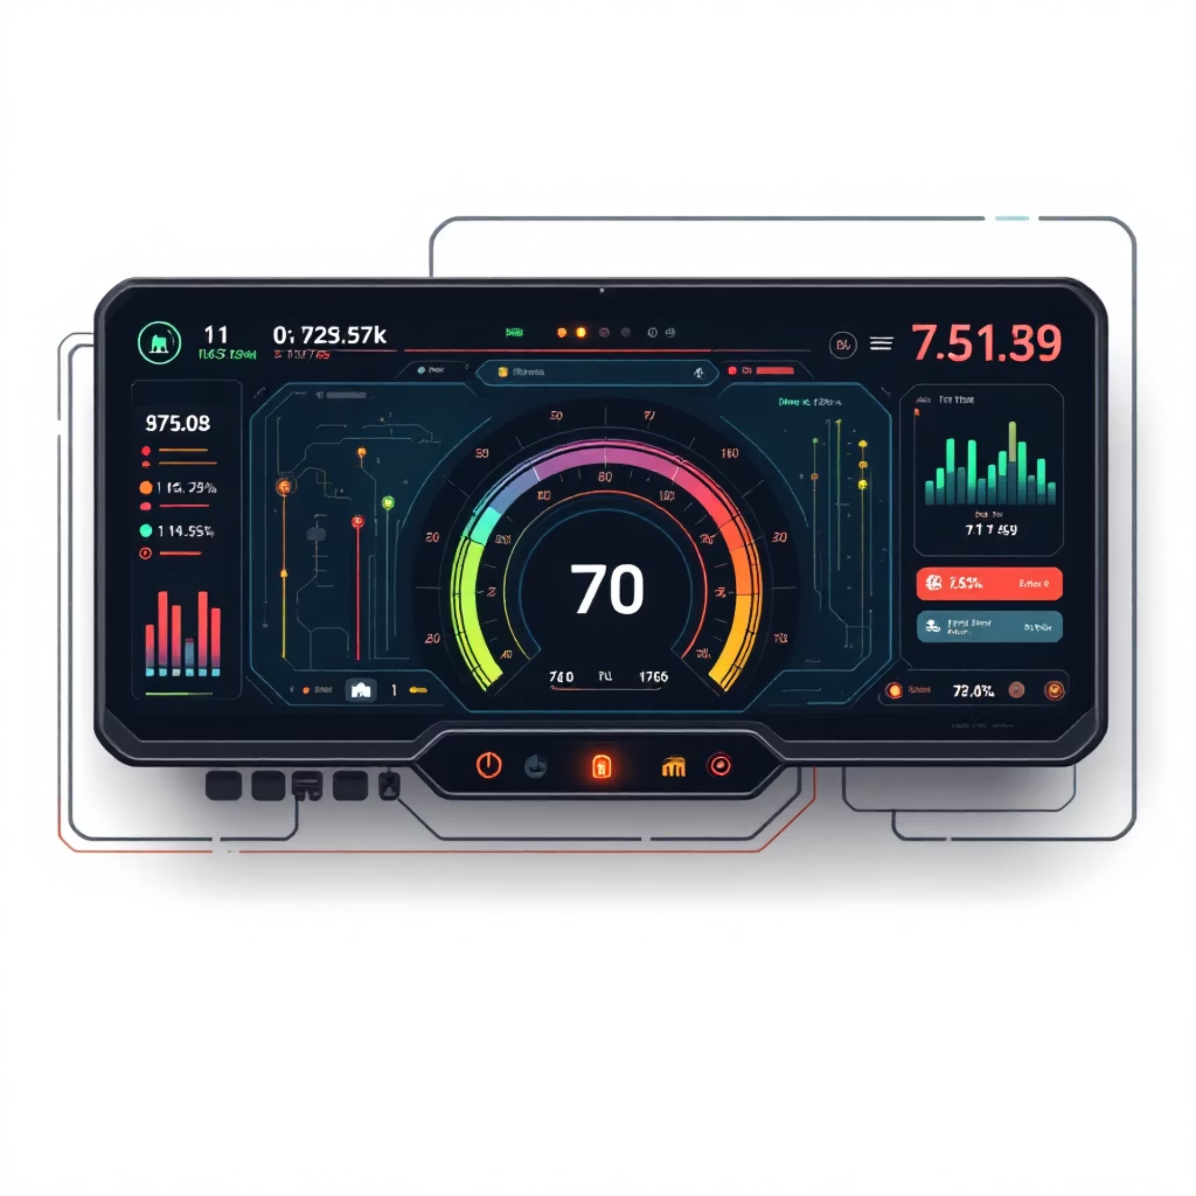
Live Project Demo: The Mechanic Console
Intuitive User Interface
Clean, minimalist design for ease of use in a busy shop environment.
Dark Mode optimized for various lighting conditions.
Color-coded "Traffic Light" system (Red/Yellow/Green) for at-a-glance status.
Prioritized information display to guide mechanic decision-making.

Slide 7




Future Roadmap: Scaling & Enhancements
IoT Integration
Directly connect to motorcycle OBD-II ports for wireless, real-time data streaming.
Computer Vision
Implement cameras to auto-detect visual issues like rusted chains or oil leaks, further automating diagnostics.
Cloud Scaling
Deploy on AWS infrastructure to support multiple repair shop franchises and global expansion.

